Slide 1
West Sacramento, California Project
General Reevaluation Report
Letter of Support for the West Sacramento General Reevaluation Report
Agenda Item 4G: Resolution 2015-13
August 28, 2015
Michael J. Musto, PE
Project Manager
Flood Risk Reduction Projects
Section B
2

Slide 2



Study Sponsors
United States Army Corps of Engineers
Sacramento District (USACE)
Central Valley Flood Protection Board
(Board)
West Sacramento Area Flood Control Agency (WSAFCA)
- City of West Sacramento

Slide 3
Requested Board Action
Approve a Letter of Support, from the Central Valley Flood Protection Board to the U.S. Army Corps of Engineers; to serve as the non-federal sponsor for the improvements described in the General Reevaluation Report for the West Sacramento Project; and
Delegate to the Executive Officer the authority to sign the Letter of Support in substantially the form attached hereto.
2

Slide 4
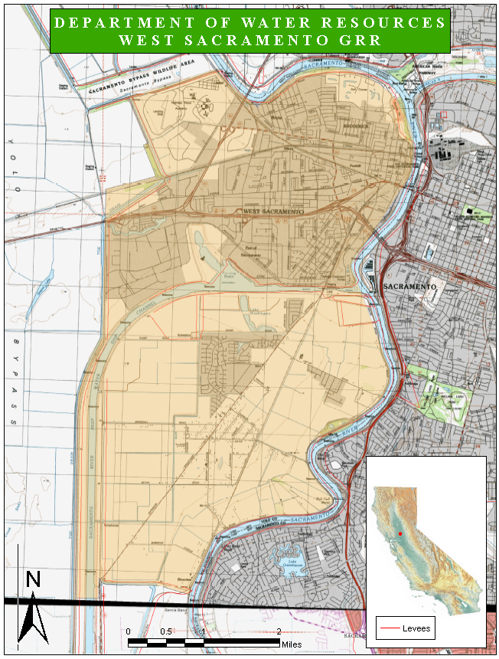
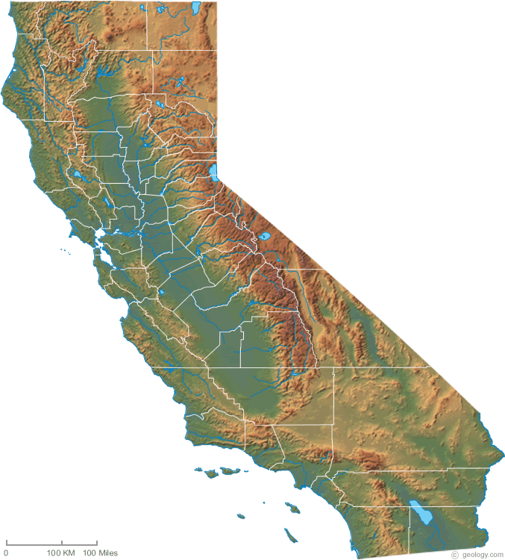
Study Area
Cross Levee
- West Sacramento GRR Study Area

Slide 5
Study Goals
The West Sacramento, California Project General Reevaluation Report will:
Evaluate flood risk reduction alternatives for the City of West Sacramento, CA.
Recommend alternatives consistent with the Central Valley Flood Protection Plan (CVFPP).
Authorize a project that will provide 200-year or greater flood protection for the City of West Sacramento in accordance with Senate Bill 5.

Slide 6
History
1998-2002 Original West Sacramento Project
        Designed to provide greater than 200-year protection
2007 USACE Adopts new Certification Guidance
        Changes original protection level objectives
        Requires reevaluation to correct deficiencies
2009 Feasibility Cost Share Agreement (FCSA) between West Sacramento Area Flood Control Agency and USACE
2010 Amendment #1 to the FCSA State of California (CVFPB) added as a Non-federal Sponsor
2014 Amendment #2 to the FCSA Increased total study cost from $5.7M to $7.8M
2015 Amendment #3 to the FCSA Increased total study cost from $7.8M to $8.57M

Slide 7
USACE Study Schedule
USACE Milestones __ __________________________
Milestone #1 (Identify Alternatives) March 2012
Milestone #2 (Tentatively Selected Plan) May 2014
Milestone #3 (Agency Decision) April 2015
Milestone #4 (Final Report) Sept. 2015 (est.)
Milestone #5 (Chief’s Report) Dec. 2015 (est.)
2

Slide 8
Project Cost
Feasibility Cost Share Agreement (FCSA)
Proposed FSCA
$8,570,000
Federal Cost (50%)
$4,285,000
State Cost (25%)
$2,142,500
Local Cost (25%)
$2,142,500

Slide 9
Staff Recommendation
Adopt Resolution No. 2015-13 to:
Approve a Letter of Support, from the Central Valley Flood Protection Board to the U.S. Army Corps of Engineers; to serve as the non-federal sponsor for the improvements described in the General Reevaluation Report for the West Sacramento Project; and
Delegate to the Executive Officer the authority to sign the Letter of Support in substantially the form attached hereto.
2

Slide 10

Questions?
DWR:
Michael J. Musto, Project Manager
(916) 574-1447
michael.musto@water.ca.gov
USACE:
Bryon L. Lake, Project Manager
        (916) 557-7890
        bryon.l.lake@usace.army.mil
WSAFCA:
Greg Fabun, Flood Protection Manager
(916) 617-4655
gregf@cityofwestsacramento.org

